Slide 1
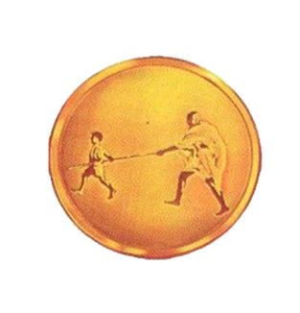
Presentation on “UNDERWATER ROV”
Mahatma Gandhi Mission’s College of Engineering and Technology,
A-9,Sector-62,Noida-201301.
Team no : 901
GUIDED BY:
Mrs. Poonam Yadav
SUBMITTED BY:
Naman Sharma
Sushant Gupta
Kuldeep Singh Parihar
Sonu Jha

Slide 2
INTRODUCTION
The project “UNDERWATER ROV” targets the aquatic or marine region for its working.
This project is basically a drone that has its operation inside the water body.
Remotely operated underwater vehicles (ROVs) are remote control underwater robots driven by an individual on the surface.
The ROVs will be equipped with a video camera, propulsion system, and lights.
The propulsion system is responsible for the movement of the ROV in the water.

Slide 3
OBJECTIVE
This project is designed to dive inside the water body and acquire the information user needs.
The project can provide information regarding the various aquatic species or to assist in search and rescue operations.
Other than this, the project can also be used for underwater videography and to assist the divers.

Slide 4
SOFTWARE USED
Arduino IDE
Blynk App
V380 App

Slide 5
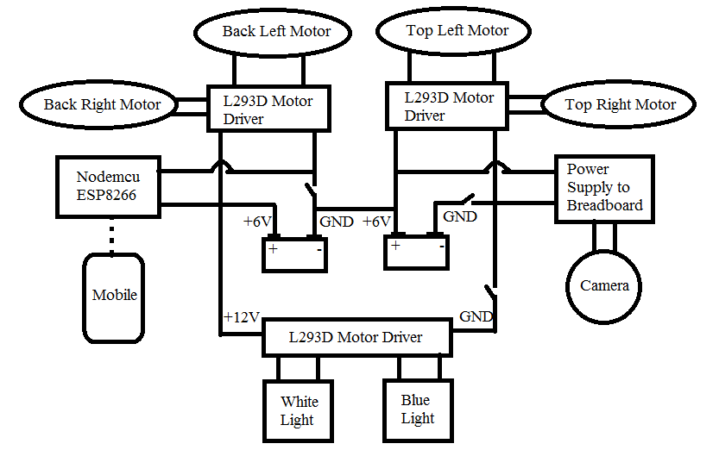
BLOCK DIAGRAM

Slide 6
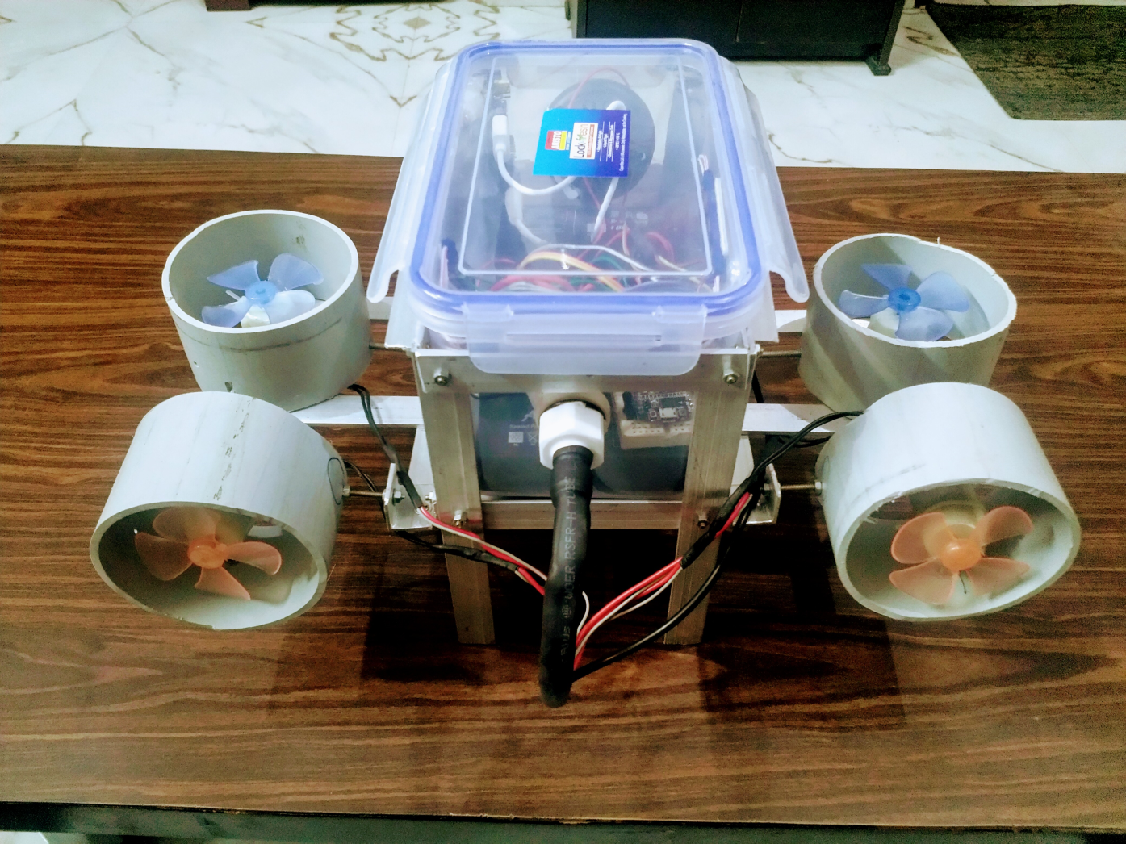
PHYSICAL 3D MODEL

Slide 7
FLOW CHART
Start
Send signal wireless module
No
If button is pressed
Yes
Wireless module Receive data
Microcontroller activates the motor to move
END

Slide 8
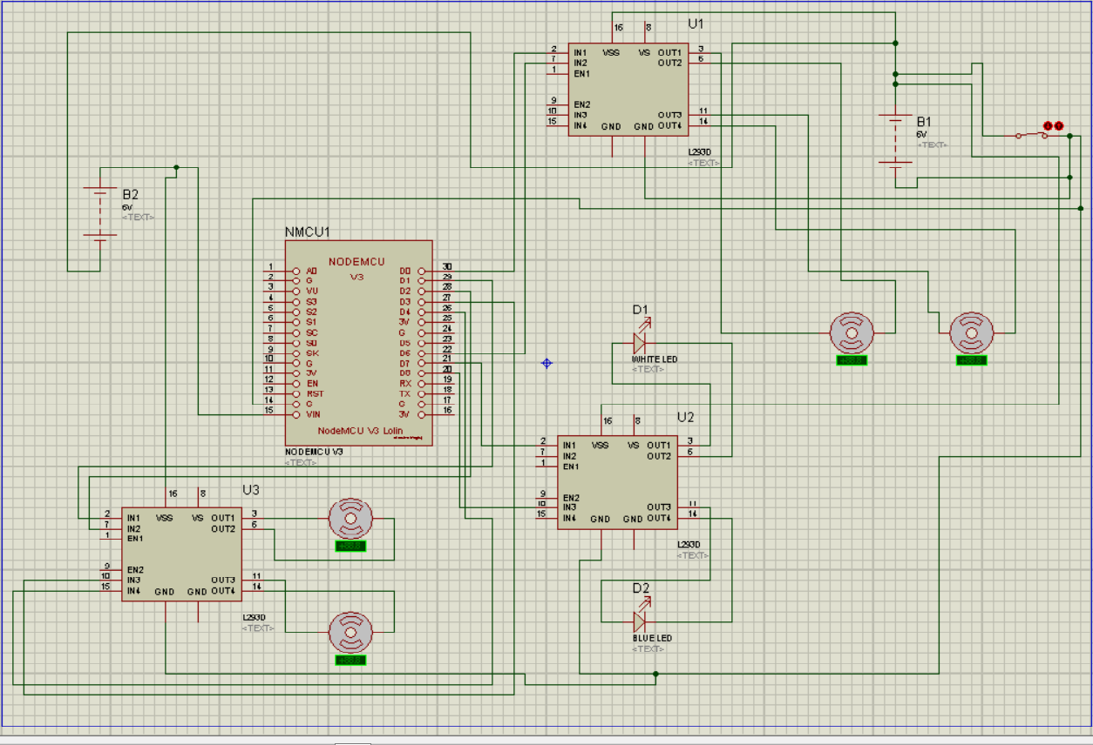
CIRCUIT DIAGRAM

Slide 9
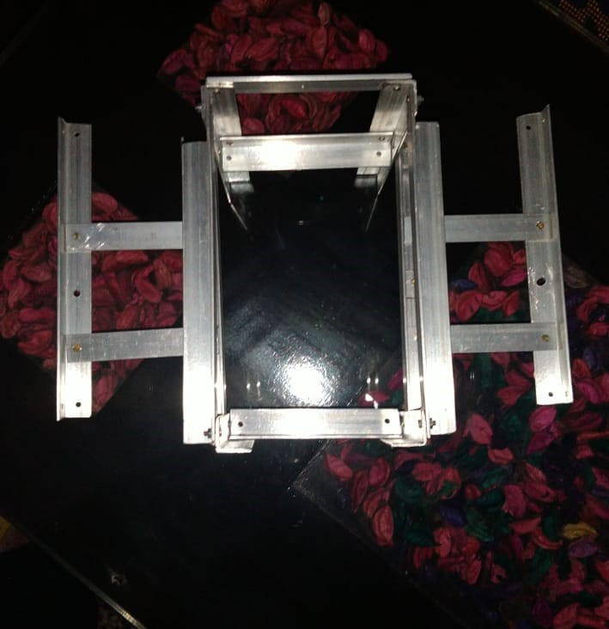
IMPLEMENTATION
Step 1: Designing the structure of ROV.

Slide 10
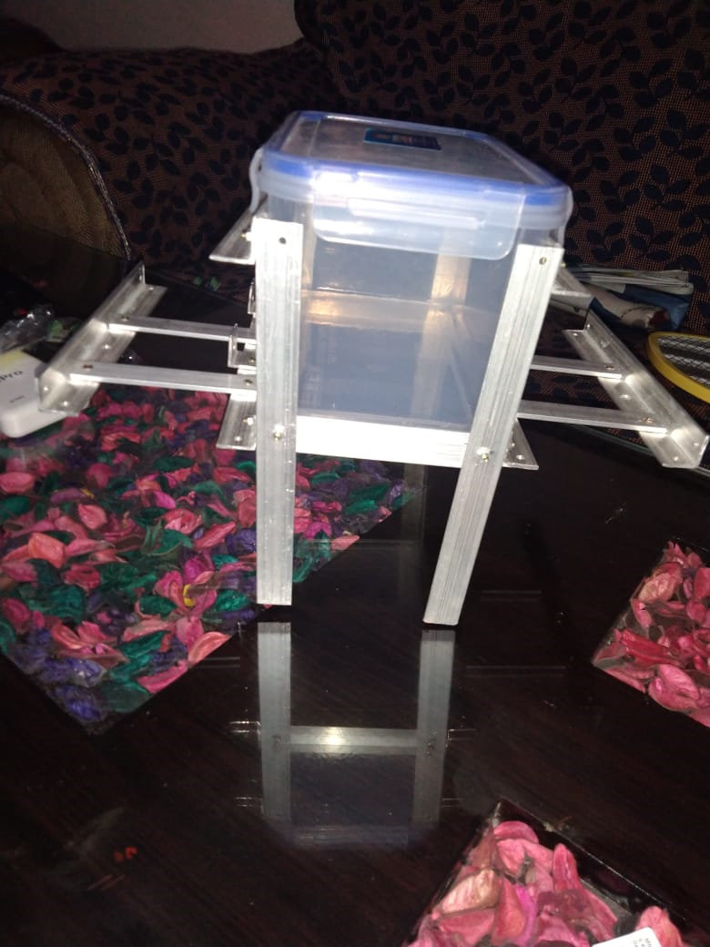
Step 2: The Structure attached with the water tight box.

Slide 11
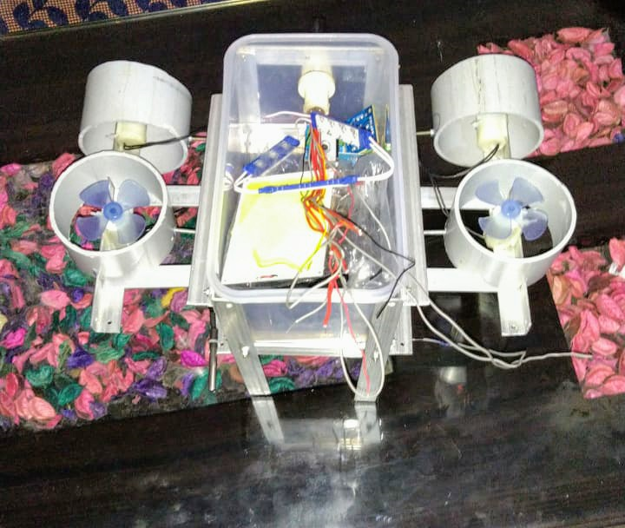
Step 3: The whole connection of components installed in the box.

Slide 12
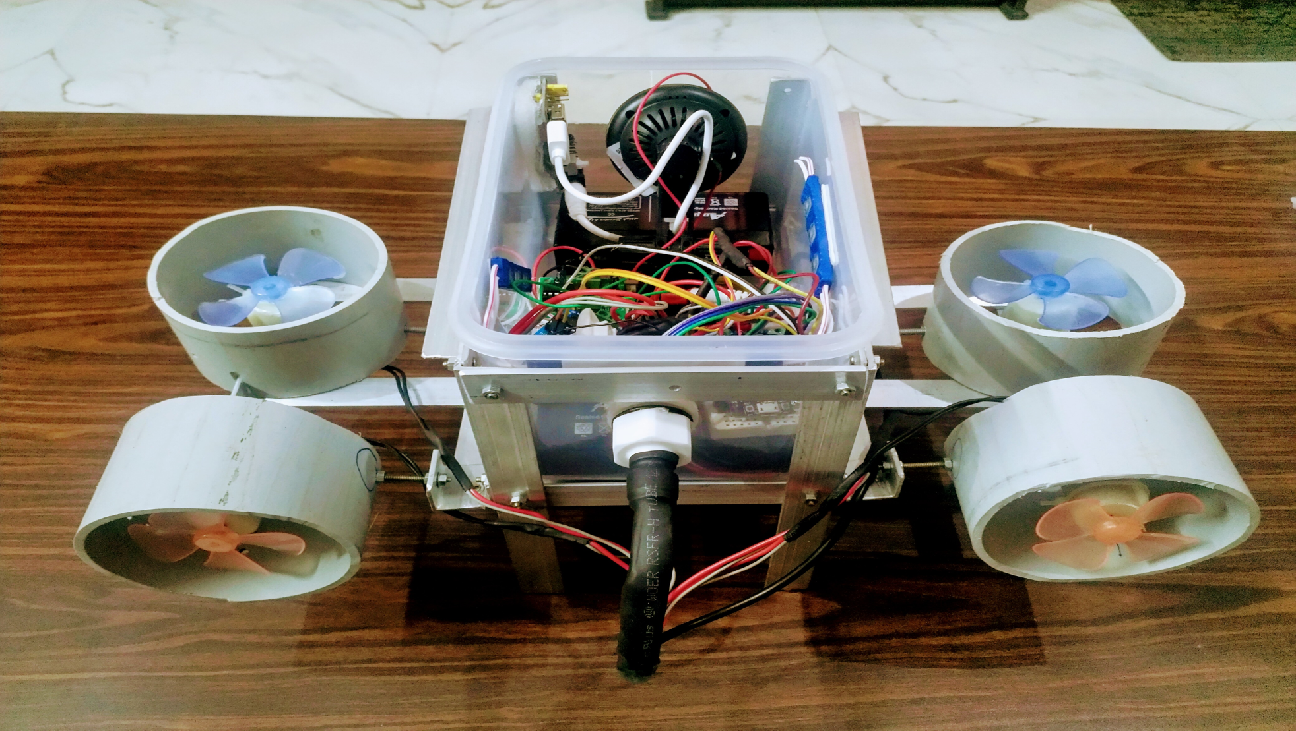
Step 4: The wire of Motors and temperature sensor inserted through tube to make the water resistant box.

Slide 13
ADVANTAGE
Leakage detection in deep sea oil pipes.
Spying with minimum human involvement.
Measuring temperature
Cost effective.

Slide 14
APPLICATIONS
These types of ROVs can help us understand the marine life in a better way.
Can be used for search and rescue operations.
To assist the underwater divers.
To know the ideal areas for fishing.
To monitor the sea beds and to preserve and clean the water bodies.

Slide 15
FUTURE SCOPE
In future these ROVs can involve a machinery to pick up the waste in water bodies
To enhance the range of ROV
To involve a mechanism that can cut the nets in which aquatic species get entangled.
The ROV can also be disguised for spying purposes.
Improve the specifications of ROV.

Slide 16
THANK YOU

